Slide 1
Phone-Pe Transaction Insights
Project -1
Presented By
Balaji V

Slide 2

Problem Statement
Digital payment systems like Phone-Pe, understanding the dynamics of transactions, user engagement, and insurance-related data is crucial for improving services and targeting users effectively. This project aims to analyze and visualize aggregated values of payment categories, create maps for total values at state and district levels, and identify top-performing states, districts, and pin codes.

Slide 3

Tools & Technologies
Python : Data Extraction, Transformation SQL : used for storing structured data and
applying some queries.
Streamlit : Interactive web framework

Slide 4
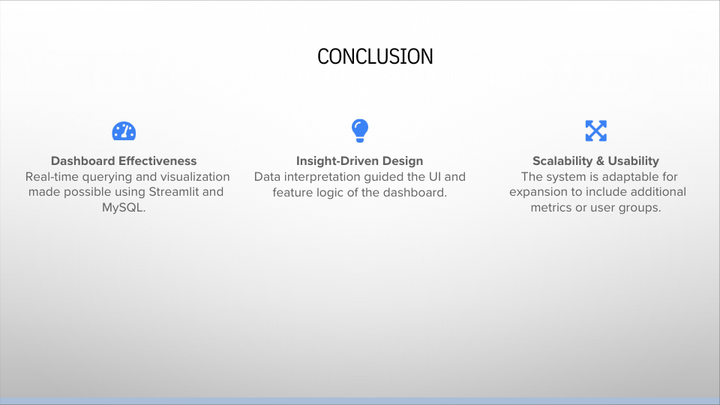

Slide 5
Thank You!

